Slide 1
CUT&RUN: Bioinformatics Challenges & Opportunities
Regulatory Genomic Forum, CCHMC
10/30/2019
Division of Biomedical Informatics
Hee Woong Lim

Slide 2
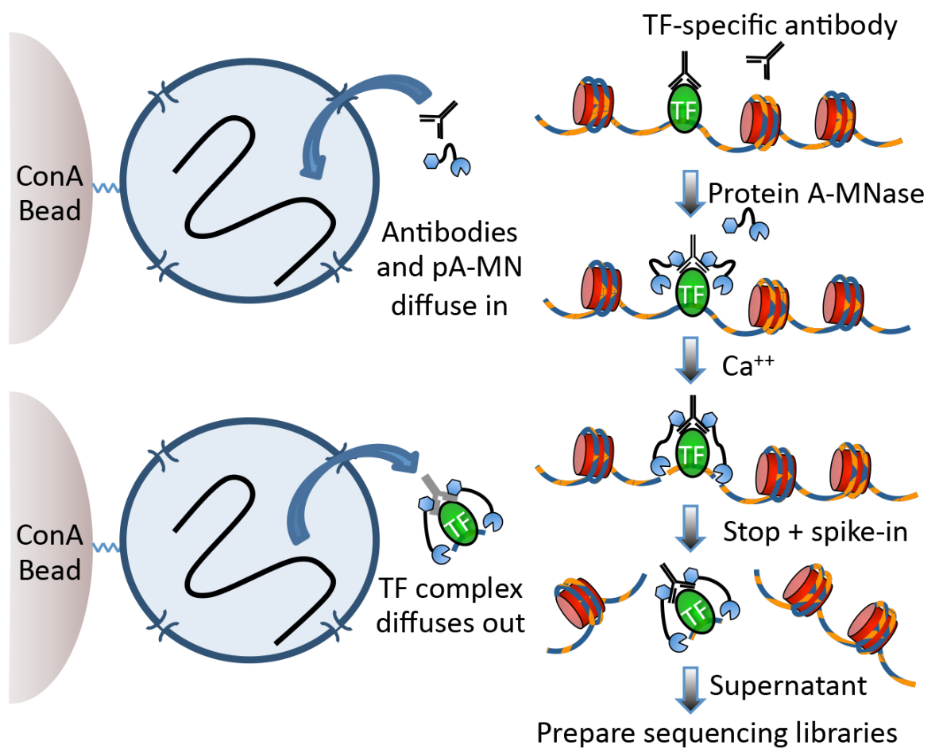
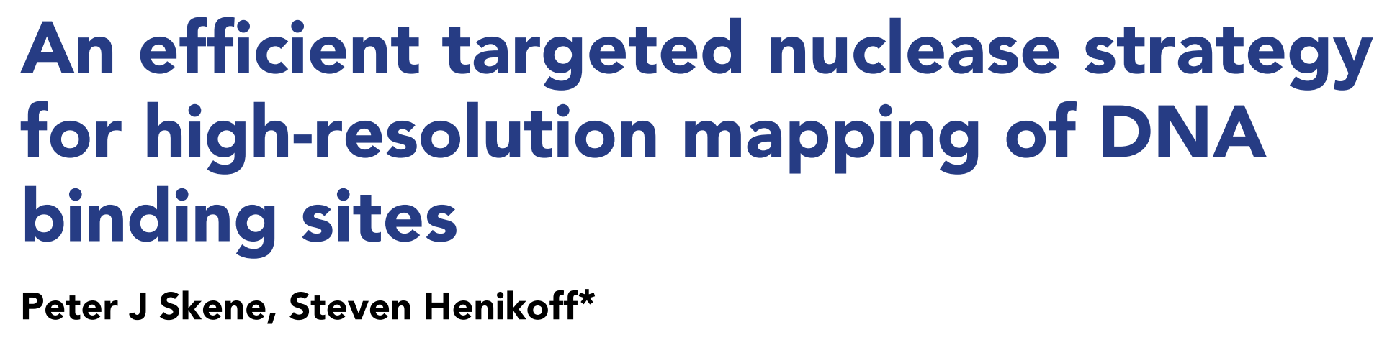
CUT&RUN: ﻿Cleavage Under Targets and Release Using Nuclease
eLife 2017
Targeted MNase-seq

Slide 3
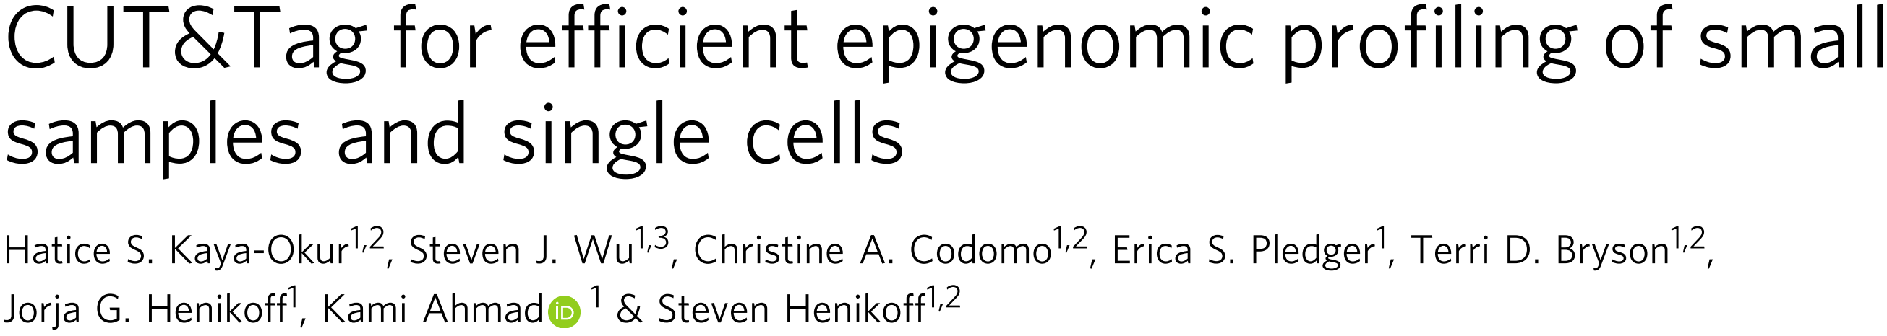
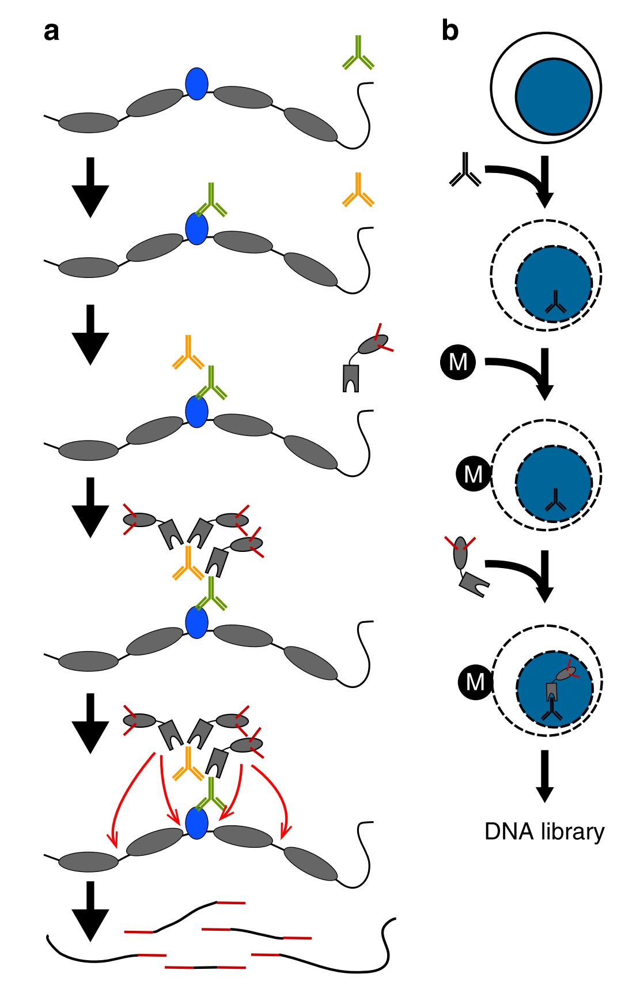
Nature Communications 2019
Primary antibody
+ secondary antibody: to enhancer local concentration of antibody
+ pA-Tn5: pre-loaded sequencing adapters
Targeted ATAC-seq

Slide 4
Analytics Roadmap
Basic analysis (ChIP-seq style)
High-resolution foot printing
Basic Processing
Fastq
Level 1
Level 2
Level 3
NUC/NFR
V-plot
Alignment
Spike-in normalization
Bias correction
Peak calling
Filtering
Enhancer heterogeneity
Motif search
High-resolution footprinting
Fragment
Pattern recognition & joint model
bigwig files
Quality Control
Size distribution
less intervention
more ad hoc analysis involved
Signal enrichment
NFR: Nucleosome free reads
NUC: Nucleosomal reads

Slide 5
Basic Analysis

Slide 6
Alignment
﻿Henikoff group (eLife 2017)
Bowtie2
--local --very-sensitive-local --no-unal --no-mixed --no- discordant --phred33 -I 10 -X 700
Generally very short read length: 25bp PE
Fazzio group (uliCUT&RUN)
﻿Trimmed to 25 bases
Bowtie2 with the parameters -N 1 and -X 1000
Lim
STAR aligner
--alignSJDBoverhangMin 999 --alignIntronMax 1 --alignMatesGapMax 2000 --outFilterMultimapNmax 1 --outFilterMismatchNoverLmax 0.05
Faster than bowtie2
Large memory required (> 30GB)
> 85% unique mapping ratio for internal data
Planned
--alignEndsProtrude (> STAR 2.6.1): to handle low alignment rate when self-complementary
May need optimization for more sensitive short alignment
Note
Mot recent STAR index is not compatible with the previous ones
In case of human, avoid using UCSC genome
Read protrusion
read1
read2

Slide 7
Alignment Filtering (& Deduplication)
Filtering
Discordant alignment
Random chromosomes and scaffolds
(optional) Deduplication
Redundant fragments at the same position => single fragment
Some duplicates fragments are real especially at peaks
Need to consider library complexity
If library is mostly unique, it is OK to go without deduplication

Slide 8
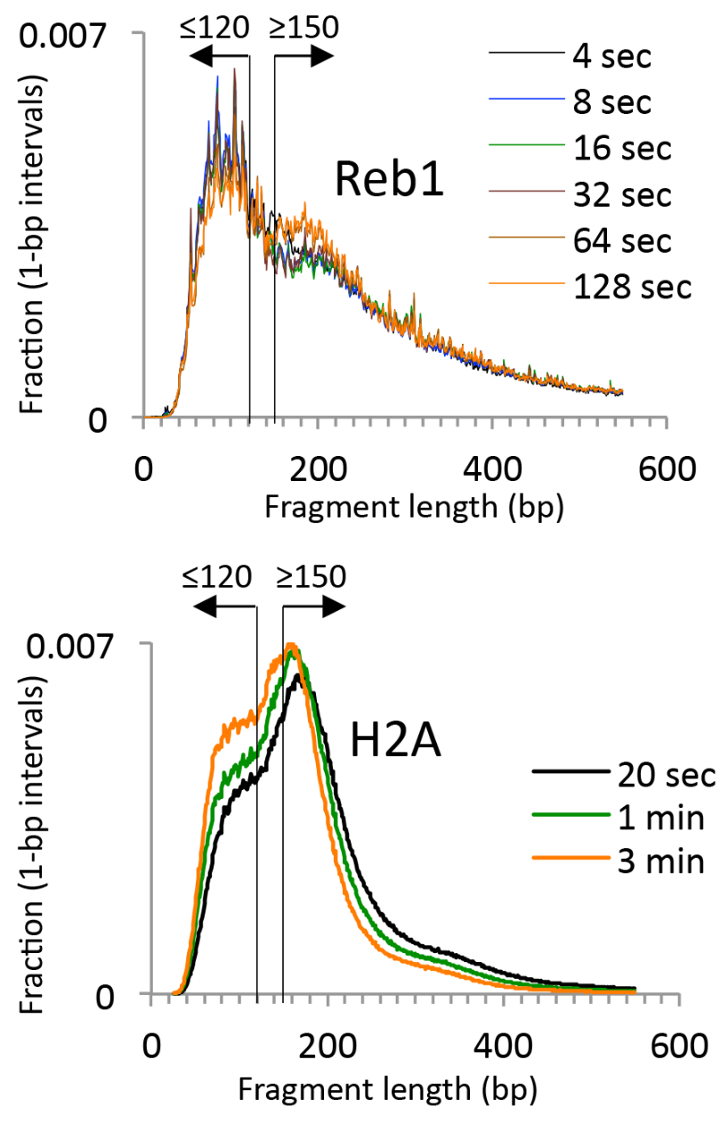
Fragment Size Distribution & Decomposition
Nucleosome free reads (NFR): < 120bp
Nucleosomal reads (NUC): > 150bp
Park lab. HNF4a/Mouse Kidney
> 150bp
Ctrl
< 120bp
> 150bp
HNF4α
< 120bp
Detection of TF binding & neighboring nucleosomes
Henikoff lab. eLife 2017

Slide 9
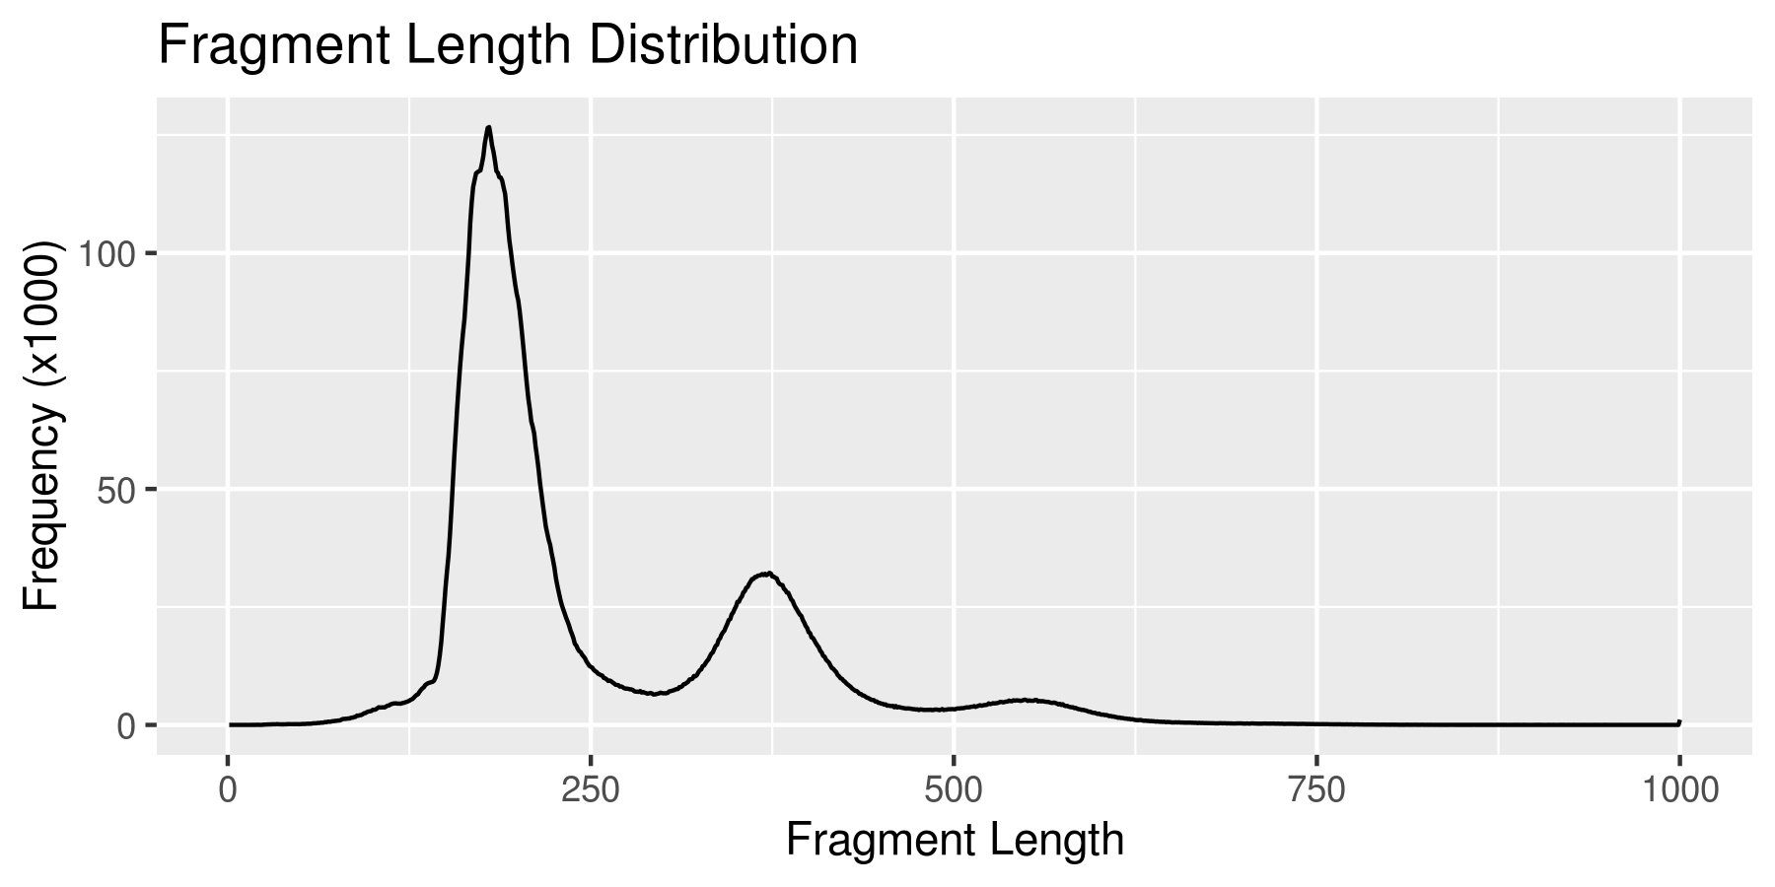

Example of Histone CUT&RUN Data with Robust Signal
Henikoff lab data
K562, H3K27ac, Abcam hiCa 1min (SRR8581597)
K562, H3K27me3 CST pAG (SRR9073701)
Planning: Large-scale collective analysis correlation signal enrichment vs length distribution
TF vs Histone
Different targets
Different labs/protocols

Slide 10
Fragment Length Distribution for QC?
hPSC CUT&RUN,
Fragment length distribution
H3K27ac / H3K27me3
H3K27me3 enrichment expected
Inactive gene →
H3K27ac enrichment expected
← Active gene
Nice enrichment of nucleosomal signal is not necessarily a good sign.
Targeted signal enrichment is another.
Iwafuchi lab.

Slide 11
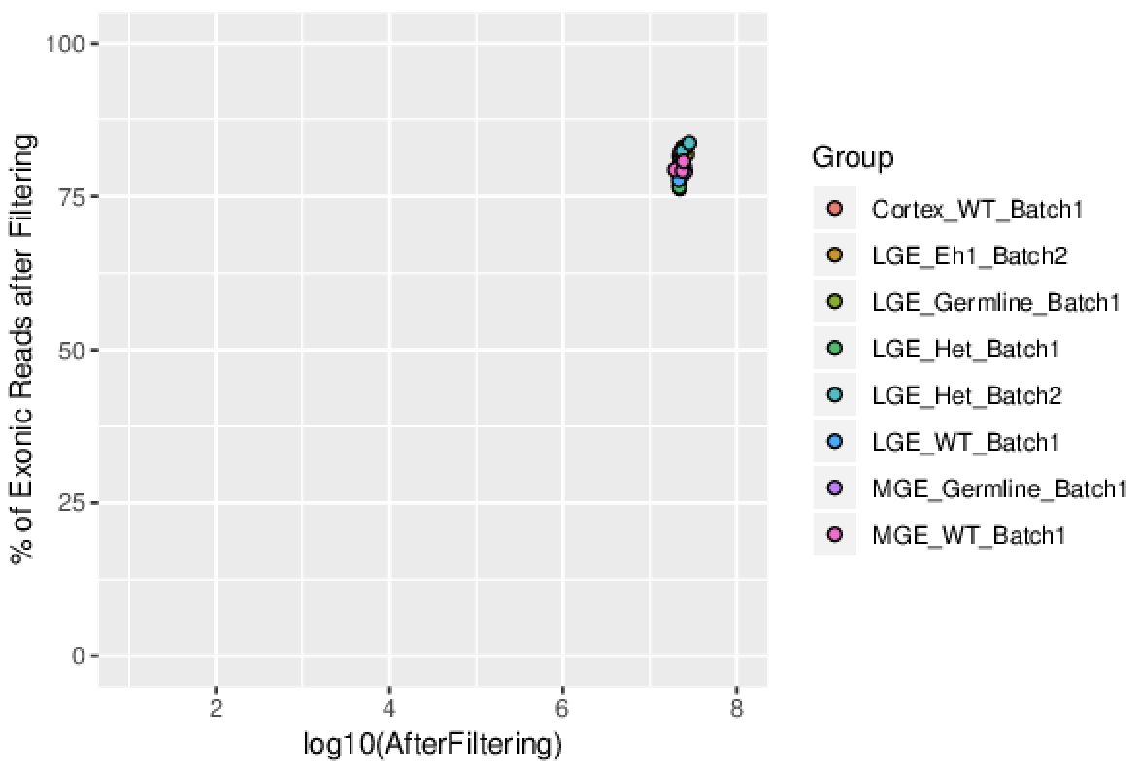
Quality Measure
Example: RNA-seq
We need comparable & quantitative quality measure.
Good samples
% of exonic reads
Sequencing depth

Slide 12
Autocorrelation
Distribution of closest distance to the next fragment
Homer
Autocorrelation Density Normalized by Read Depth using fragments (not individual reads)
http://homer.ucsd.edu/homer/ngs/tagDir.html

Slide 13
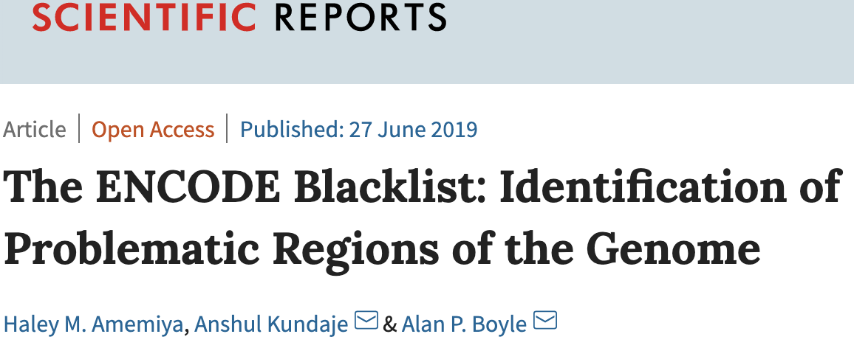
Peak Calling & BigWig Files
Fragment resize: 100 – 150bp
Planned: sub-split of di-/tri-nucleosomal fragments
Peak calling with Homer
factor: NFR reads
histone: NUC reads
Masking by ENCODE blacklist
Version 2 recently released, larger regions
https://github.com/Boyle-Lab/Blacklist/tree/master/lists
Motif search
Homer / MEME
BigWig files
NFR reads
NUC reads
All fragments

Slide 15
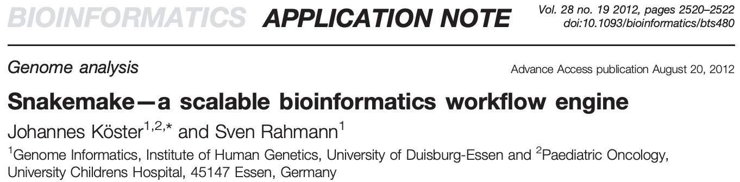
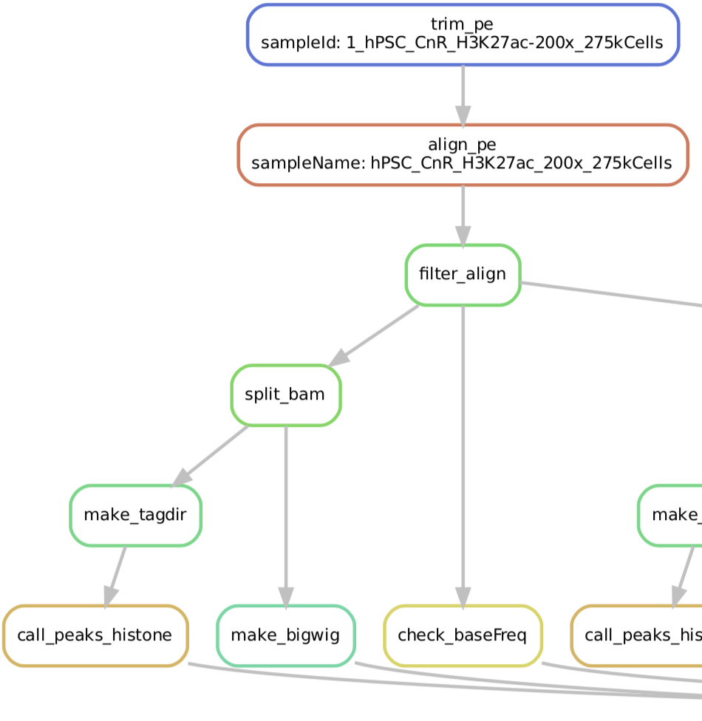
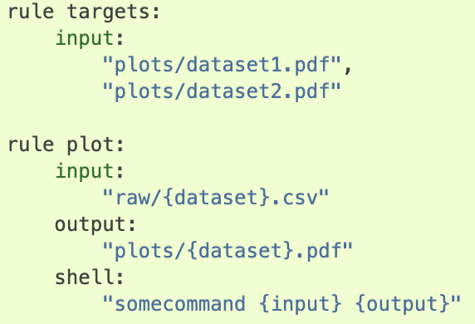
Workflow Engine: Snakemake
https://snakemake.readthedocs.io/en/stable/
Data entry + rules => automatics job generation for hierarchical process
Data list + rules (command/input/output)
➔ automatic job creation & parallel processing by dependency

Slide 16
Processing of Public Data
GSE84474: First CUT&RUN paper, eLife 2017
GSE104550: Nature Protocol 2018
GSE124557: CUT&Tag paper
GSE126612: Improved CUT&RUN, eLife 2019
GSE128499: Pioneering factor, Mol. Cell. 2019

Slide 17
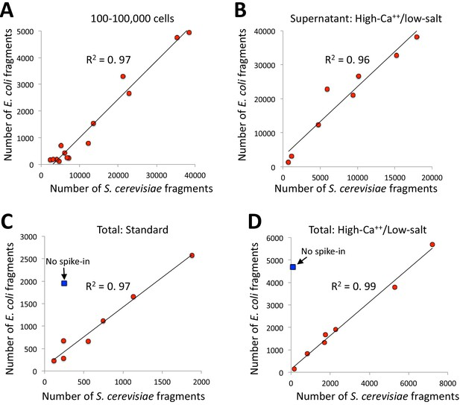
Spike-in Normalization
Henikoff lab. eLife 2019
Endogenous carry-over E coli genome?
Not enough evidence for reliability
Need more validation
Highly variable and low E coli fraction
Not comparable between
different targets
different protocols
Generally small # of E coli reads
0 % - 2% for CUT&RUN
Rarely > 50% for CUT&Tag
Depends on required sensitivity
Exogenous spike-in?

Slide 18
Spike-in Normalization: Technical Detail
When no external spike-in is used
Genome reference incorporating E coli genome
BL21 / K12 strain
When an external spike-in used
Drosophila or yeast
Options:
Hybrid genome reference: target genome + spike-in genome
Separate alignment to spike-in genome

Slide 19
High-Resolution Footprinting

Slide 20
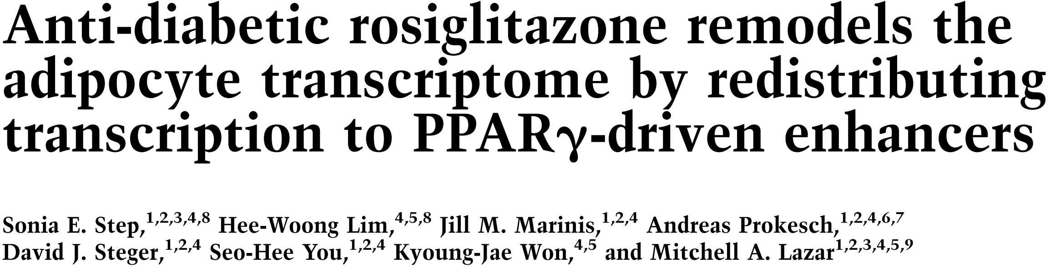
Intrinsic Heterogeneity of Enhancers: PPARγ
Rosiglitazone (rosi)
Ligand for PPARγ
Not every PPARg binding sites are activated upon rosi treatment
PPARg binding sites defined by ChIP-seq in 3T3-L1 adipocyte
Functional heterogeneity
Genes & Development 2014

Slide 21


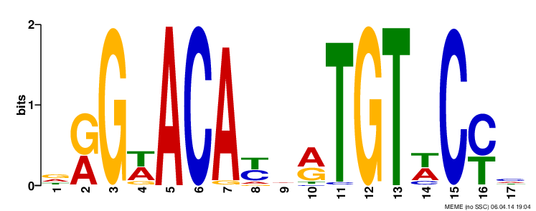



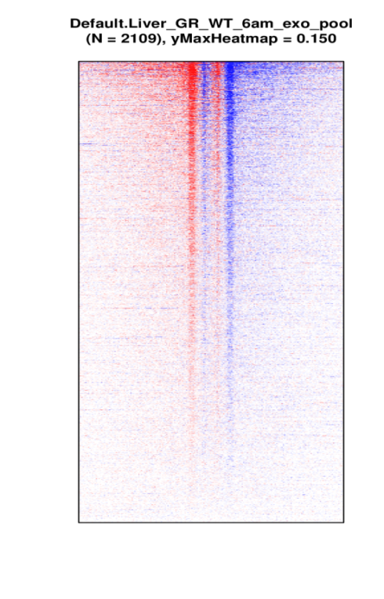
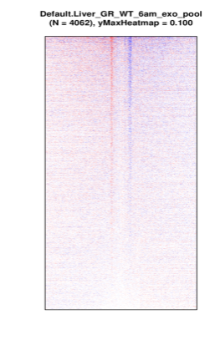
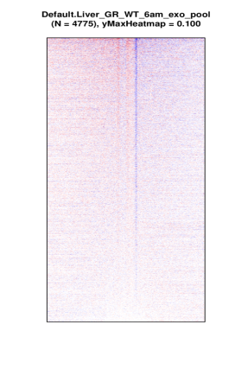
Intrinsic Heterogeneity of Enhancers: GR
GR ChIP-exo in mouse liver)
GR
GR
Sequence
Motif
P-Value
Hit %
Bg %
TF
HNF4α
10⁻¹⁷⁸⁶
49.8
17.0
GR
GRE
Half-GRE
TF motif
C/EBP
10⁻¹¹¹⁵
21.5
4.7
FOXA
10⁻⁷⁸⁹
31.4
12.4
HNF6
10⁻⁷¹⁷
17.0
4.4
GR
10⁻⁵⁸³
13.1
3.1
GRE can explain only small fraction of GR binding
=> Dimerization-independent mechanism & function?

Slide 22
How to Stratify Intrinsically Heterogeneous Enhancers?
High-resolution footprinting

Slide 23
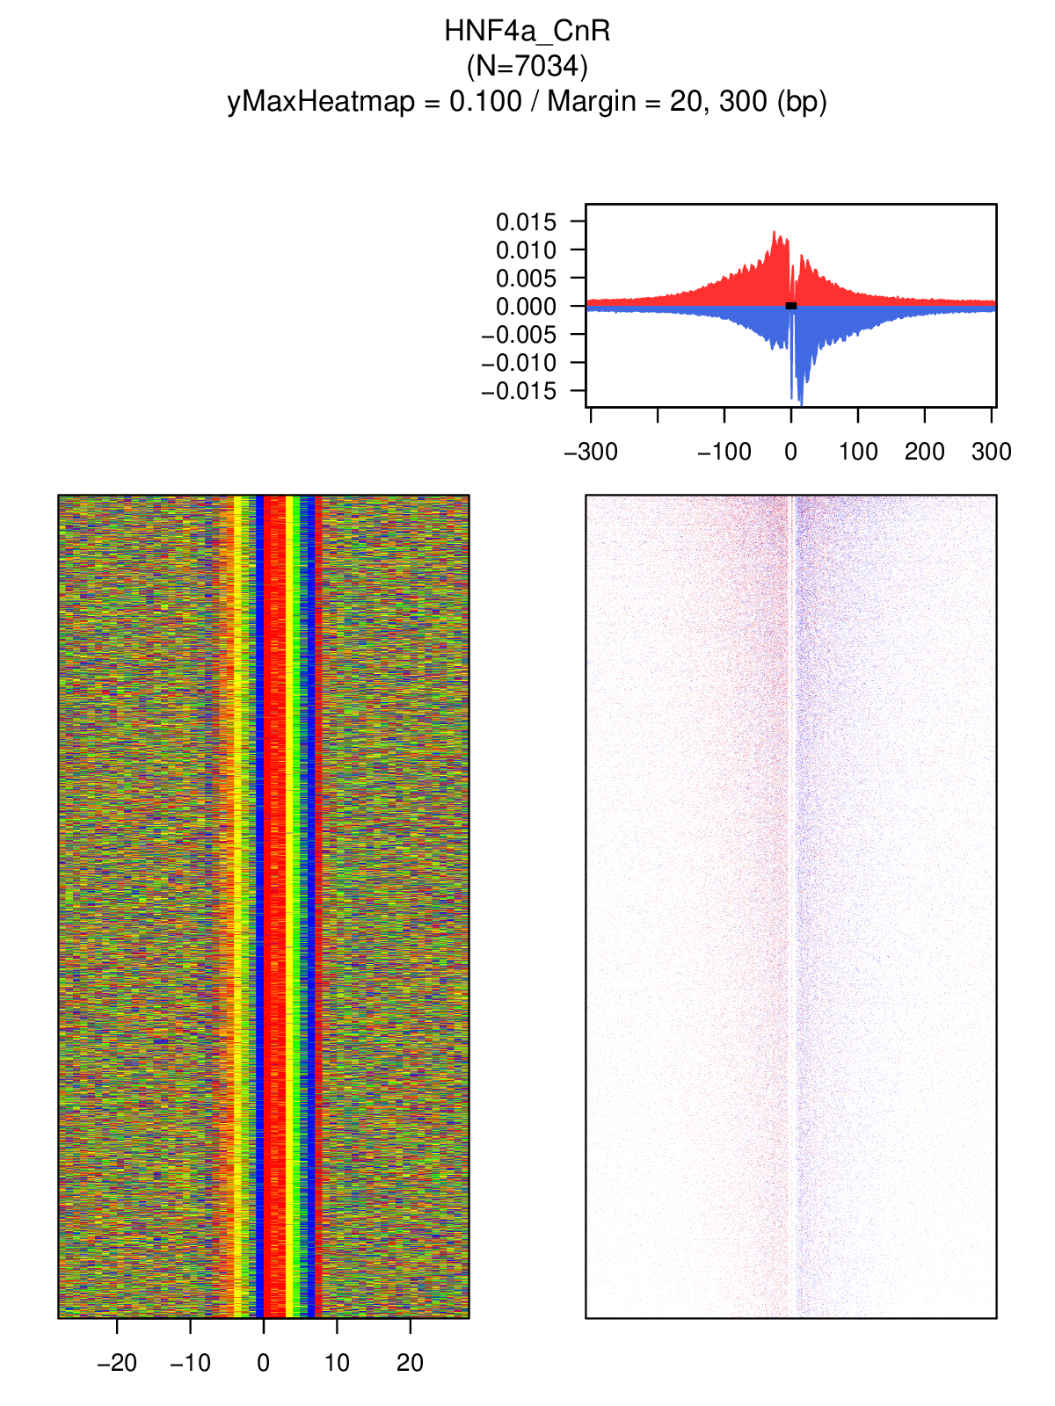
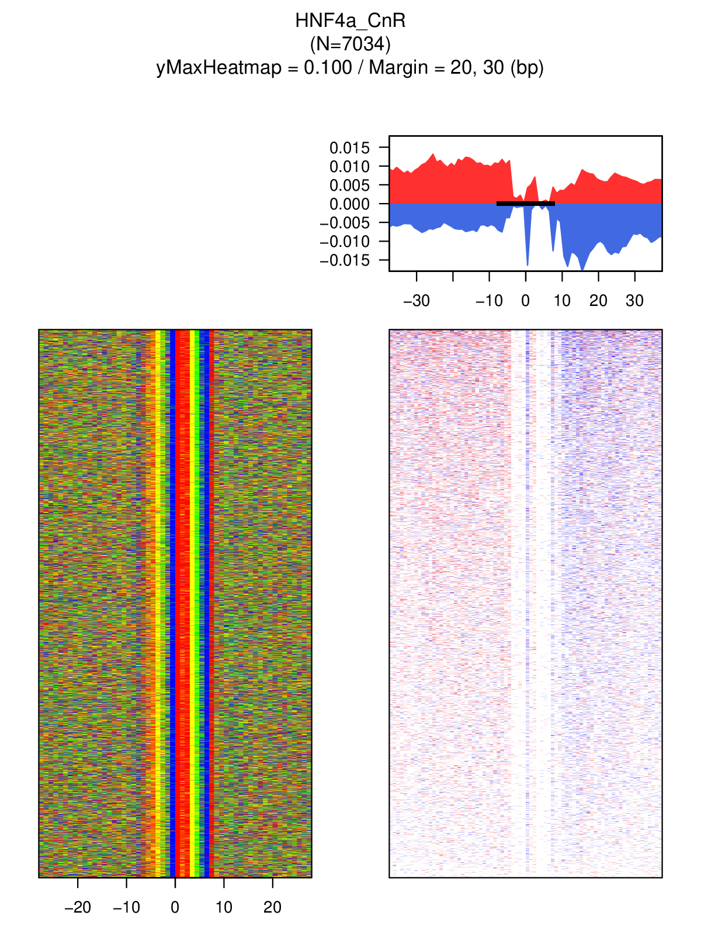
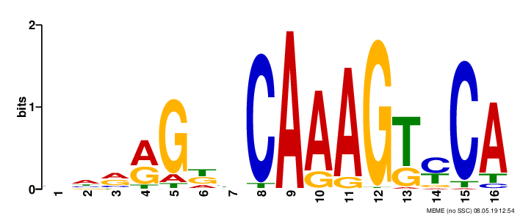
HNF4a CUT&RUN – Mouse Kidney
Park lab.
?
HNF4a
NR
X
N=7034
Cleavage between NRs?
Or
Sequence-specific bias?
Peak calling
Motif search
High-confidence
motif loci
Visualization

Slide 24
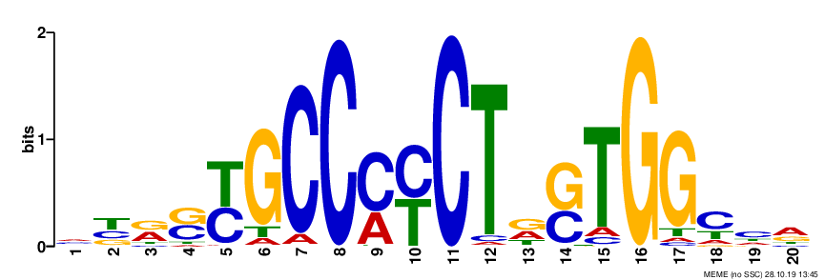
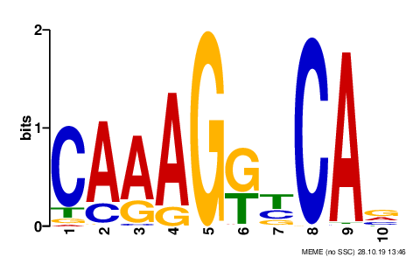
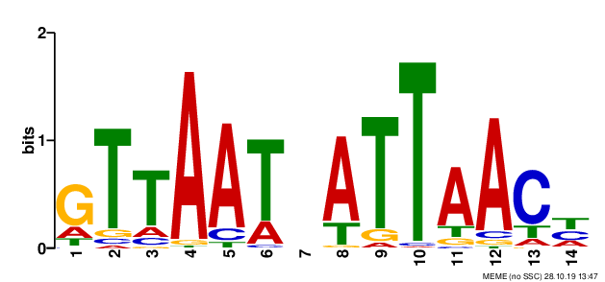
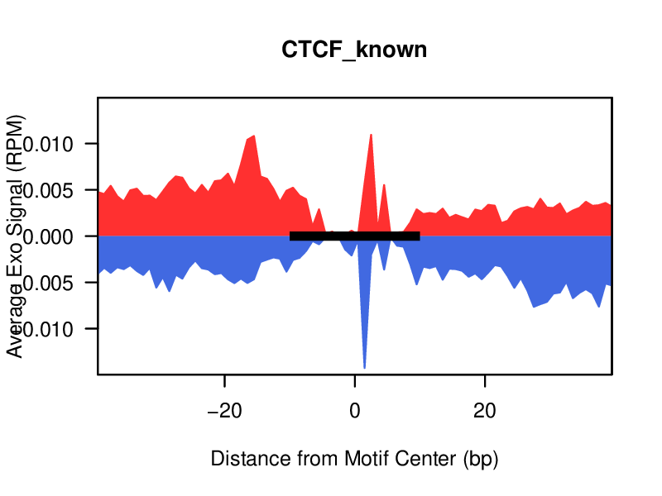
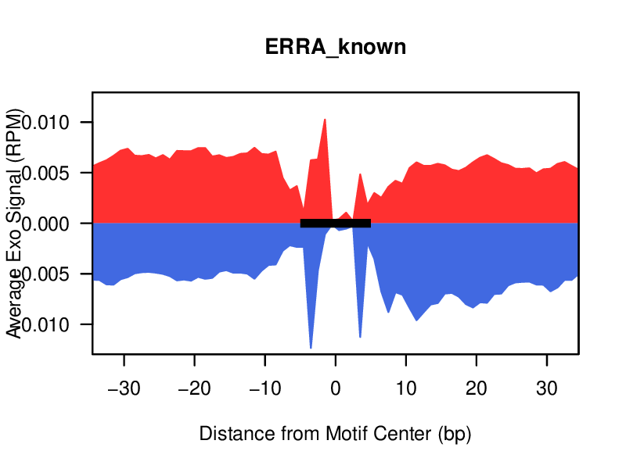
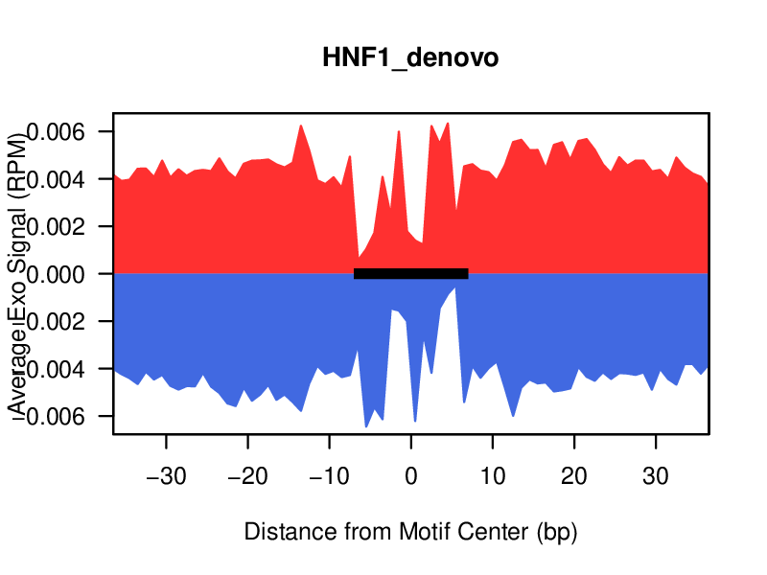
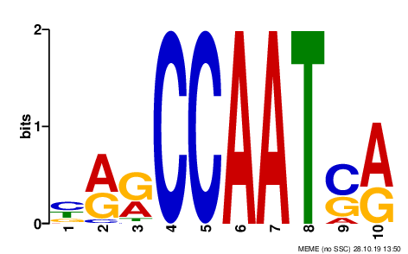
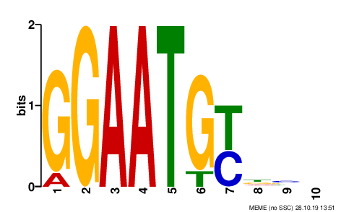
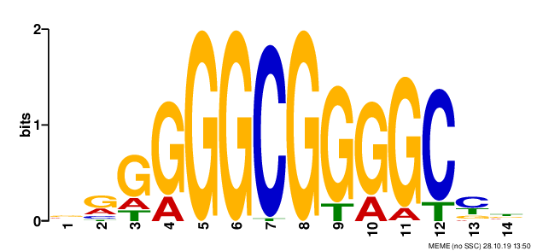
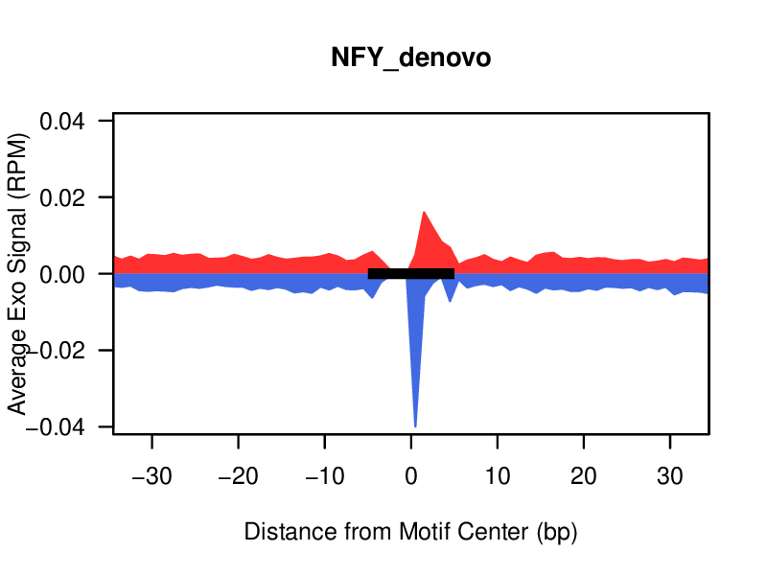
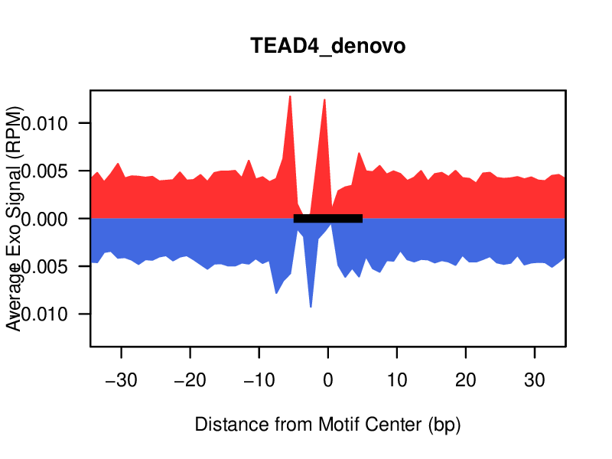
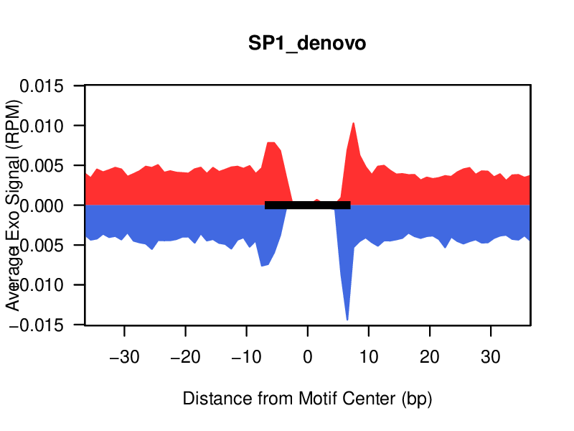
HNF4a CUT&RUN – Mouse Kidney
Tethering?
Or
Neighboring binding?

Slide 25
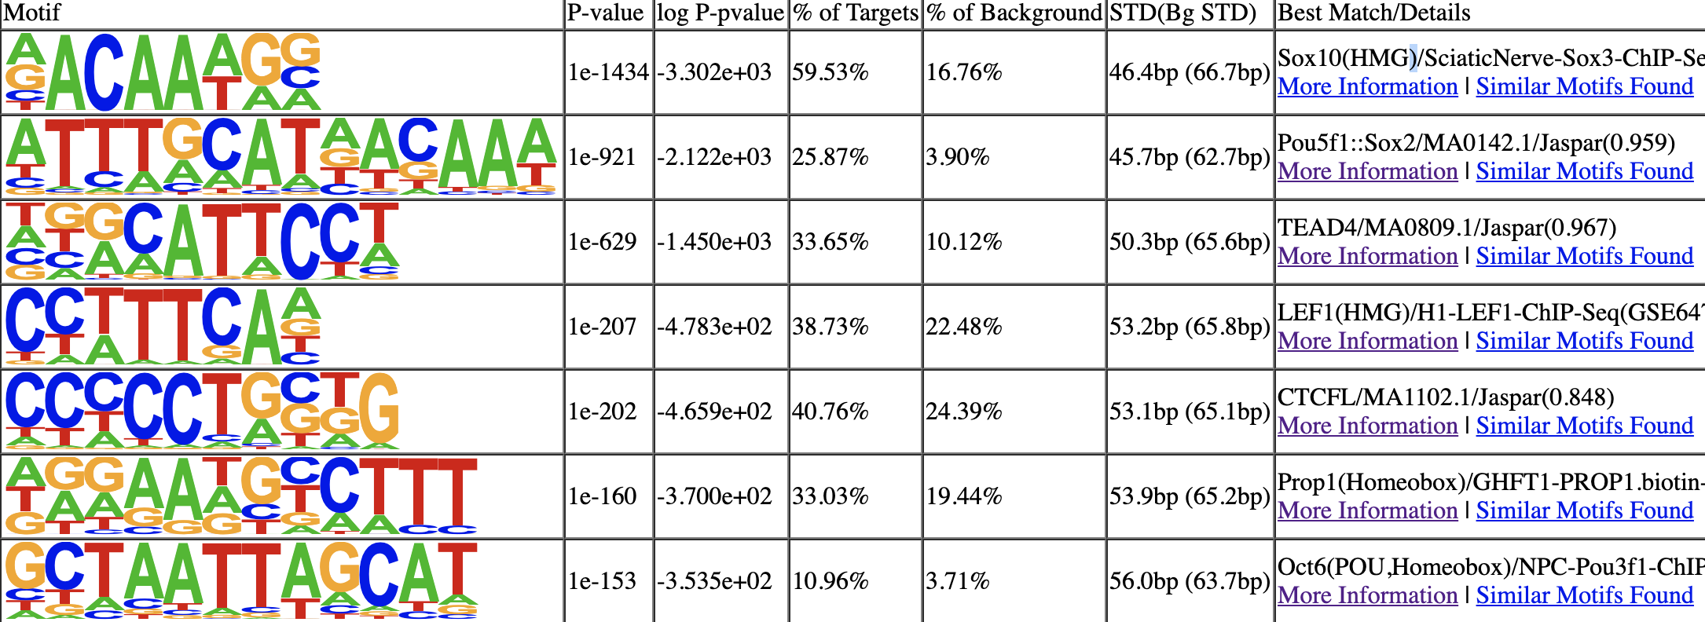
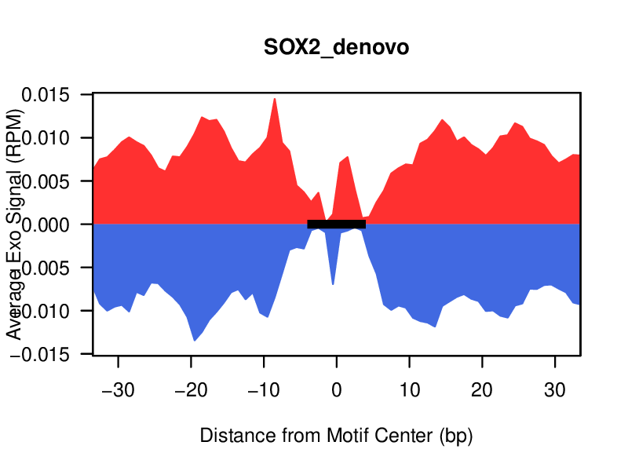
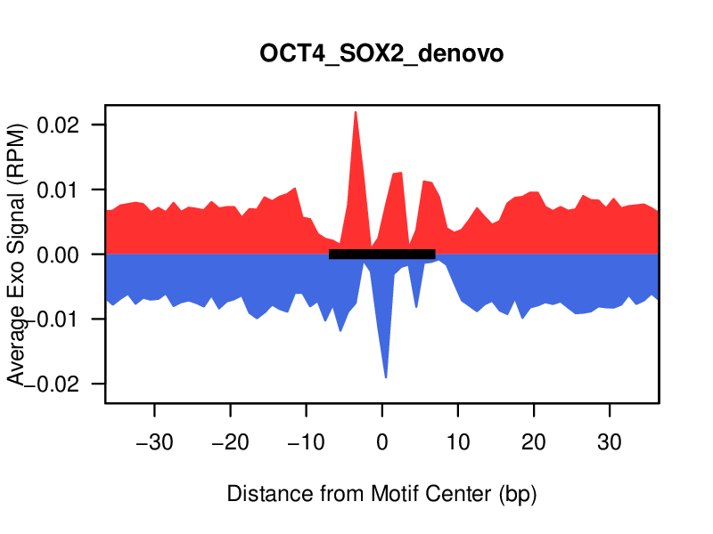
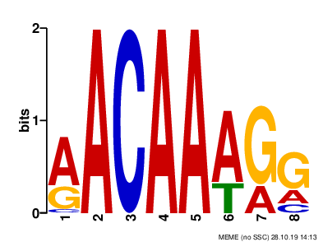
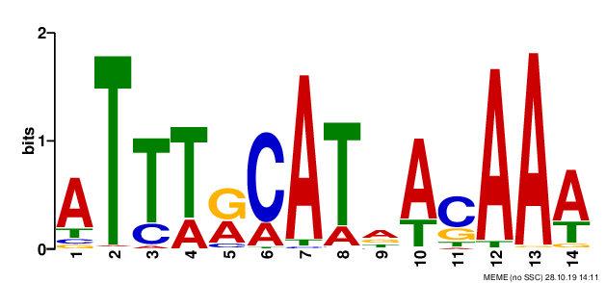
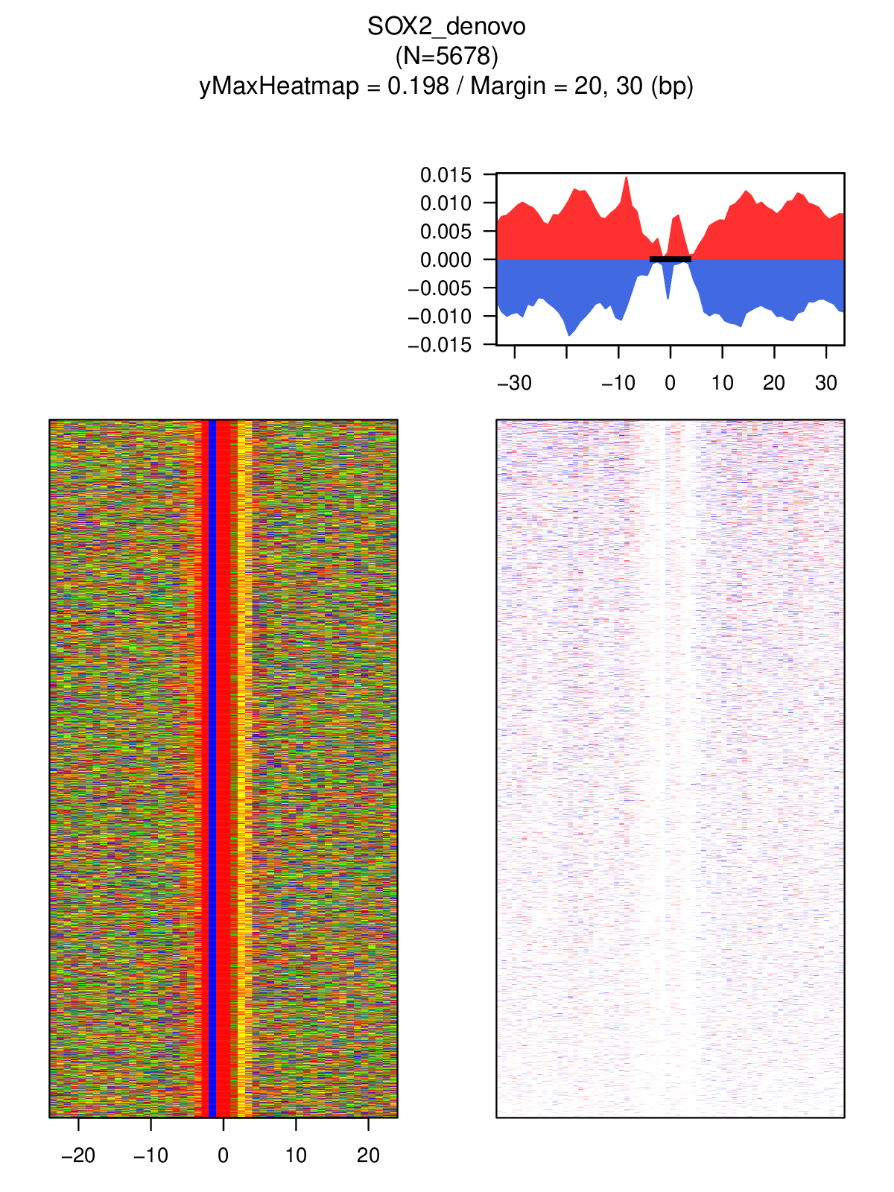
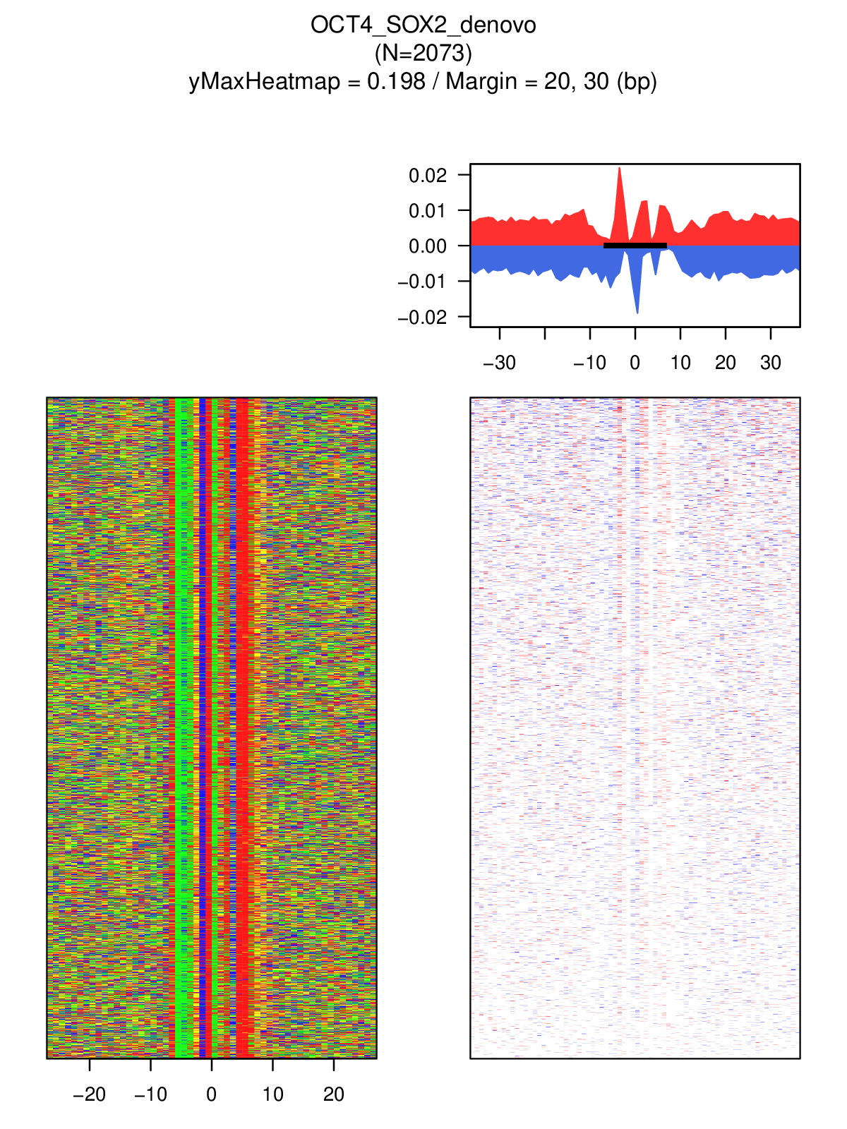
SOX2 CUT&RUN – H1 Cell
GSE128499
SOX2
OCT4:SOX2
TEAD4
HMG
CTCF
Prop1
OCT6/8
SOX2
OCT4:SOX2

Slide 26
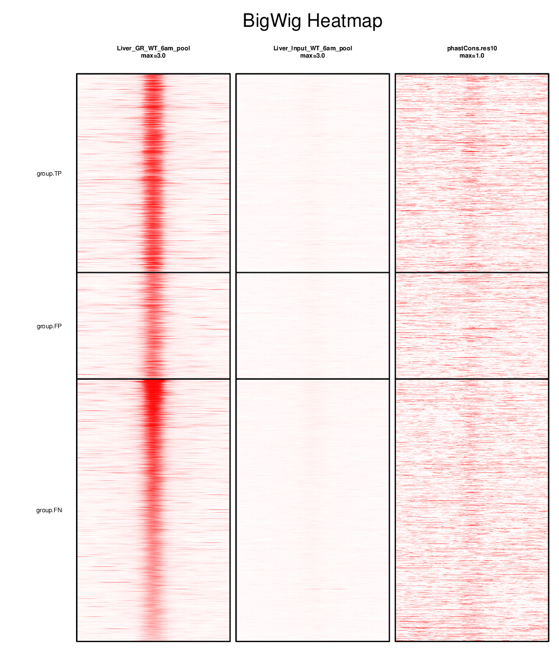
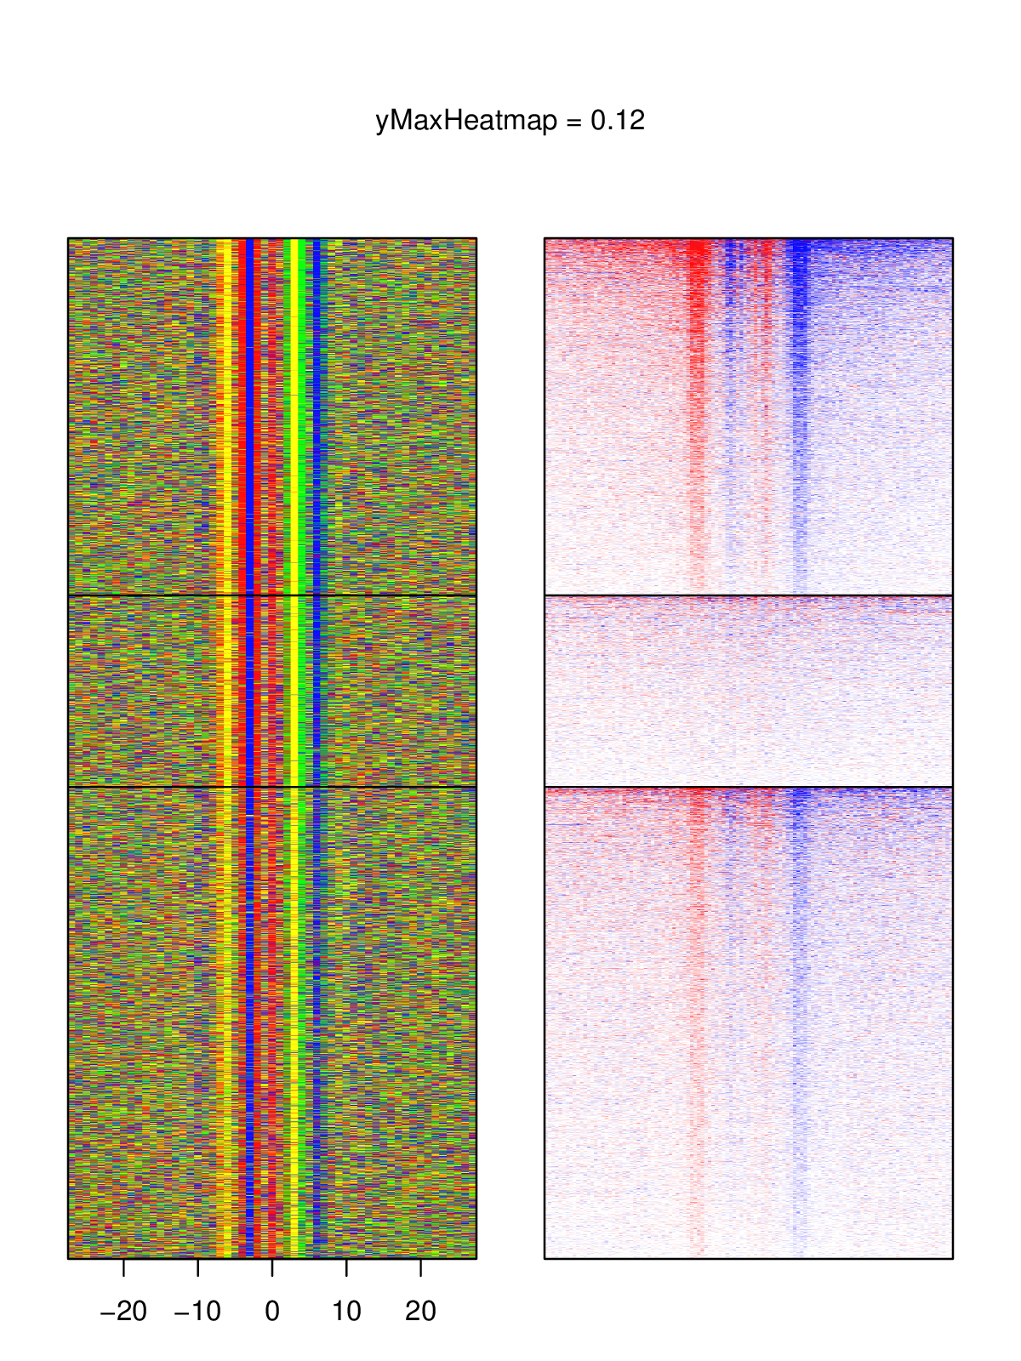
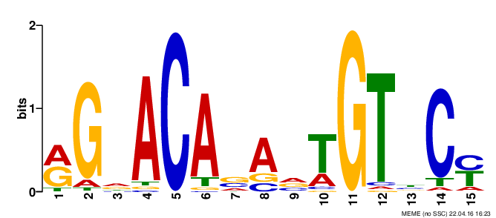
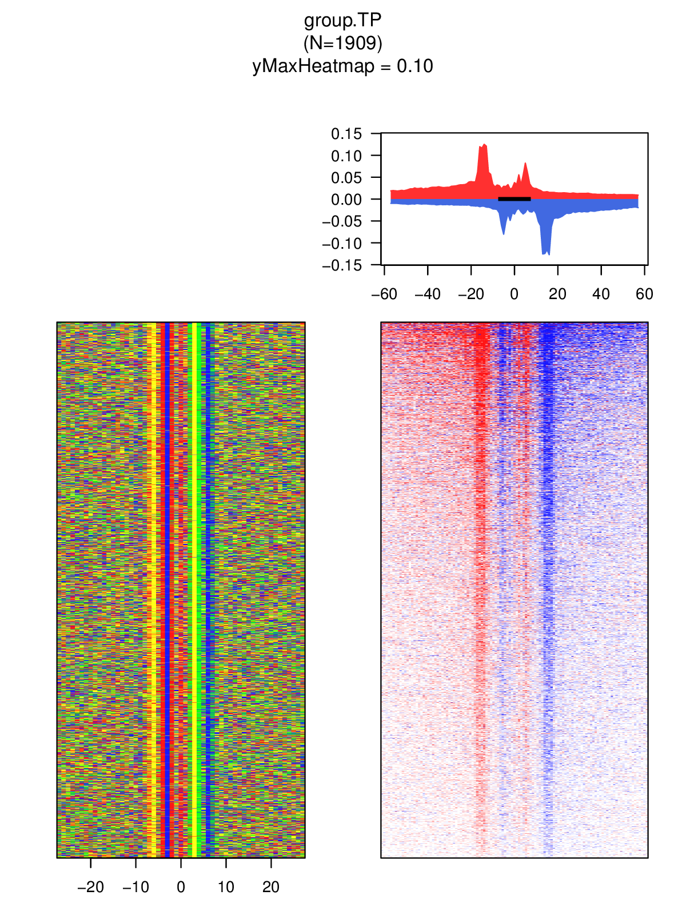
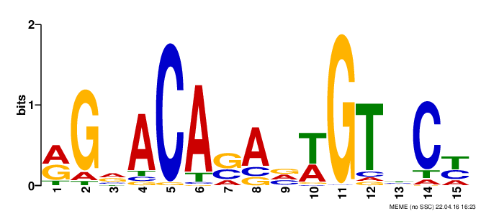
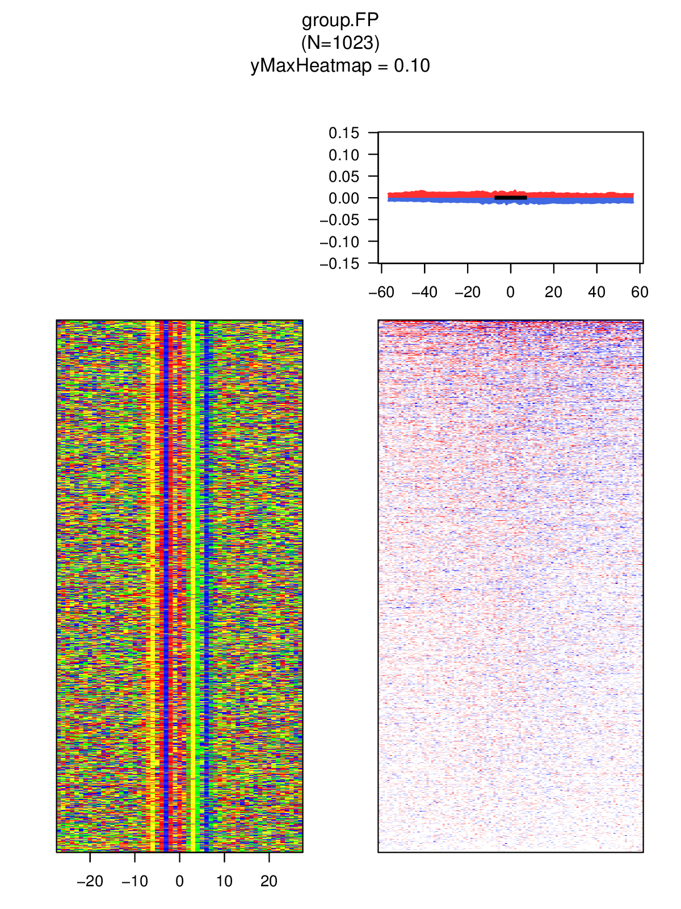
Limitation of Motif-Anchoring Footprinting
Homologous motifs
Sequence-specific bias
Binding at degenerate motif
False-positive binding at stringent motif
Example of GR ChIP-exo
ChIP-seq
ChIP-exo
GR
Input
A/C/G/T
+/− 500bp
+/− 40bp
Dimeric
0
3
Monomeric
Y-axis: +/− 0.14 RPM

Slide 27
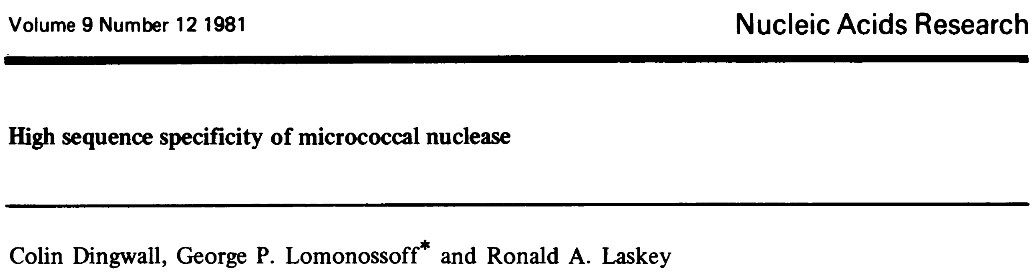
Sequence-Specific Bias of MNase
“Cleavage rate is 30 times greater at A/T than G/C”
Sequence bias at CUT&RUN / Tag cleavage sites
Planned:
k-mer based correction
observed k-mer count / expected count
GSE128499
GSE124557

Slide 28
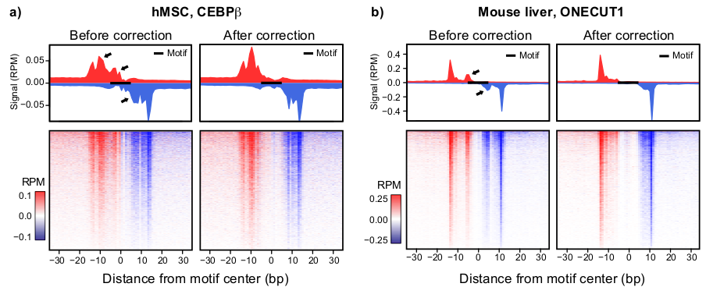
Example of Bias Correction by k-mer Counts ChIP-exo
Unpublished

Slide 29
Unbiased Stratification of TF Binding Footprints
Can we identify distinct binding mode of a TF by CUT&RUN signal?

Slide 30
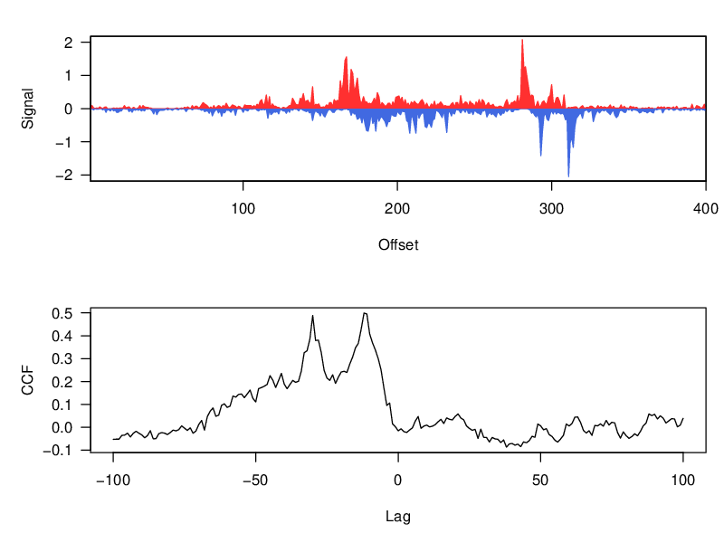
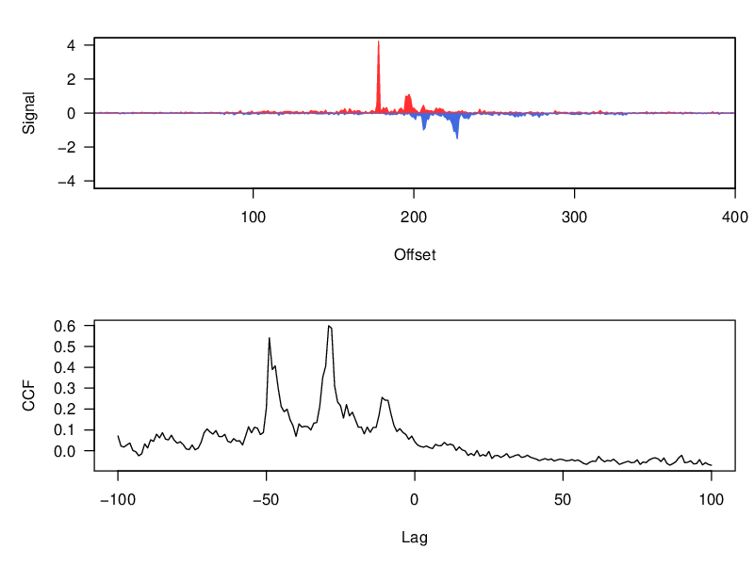
Example of Unbiased Identification of a Distinct Binding Mode in GR ChIP-exo
GR binding sites (200bp)
Feature extraction from ChIP-exo signal
cross-correlation
shift-invariant feature
PCA
tSNE/UMAP
Analogous to scRNA-seq analysis
where individual peak correspond to single cell

Slide 31
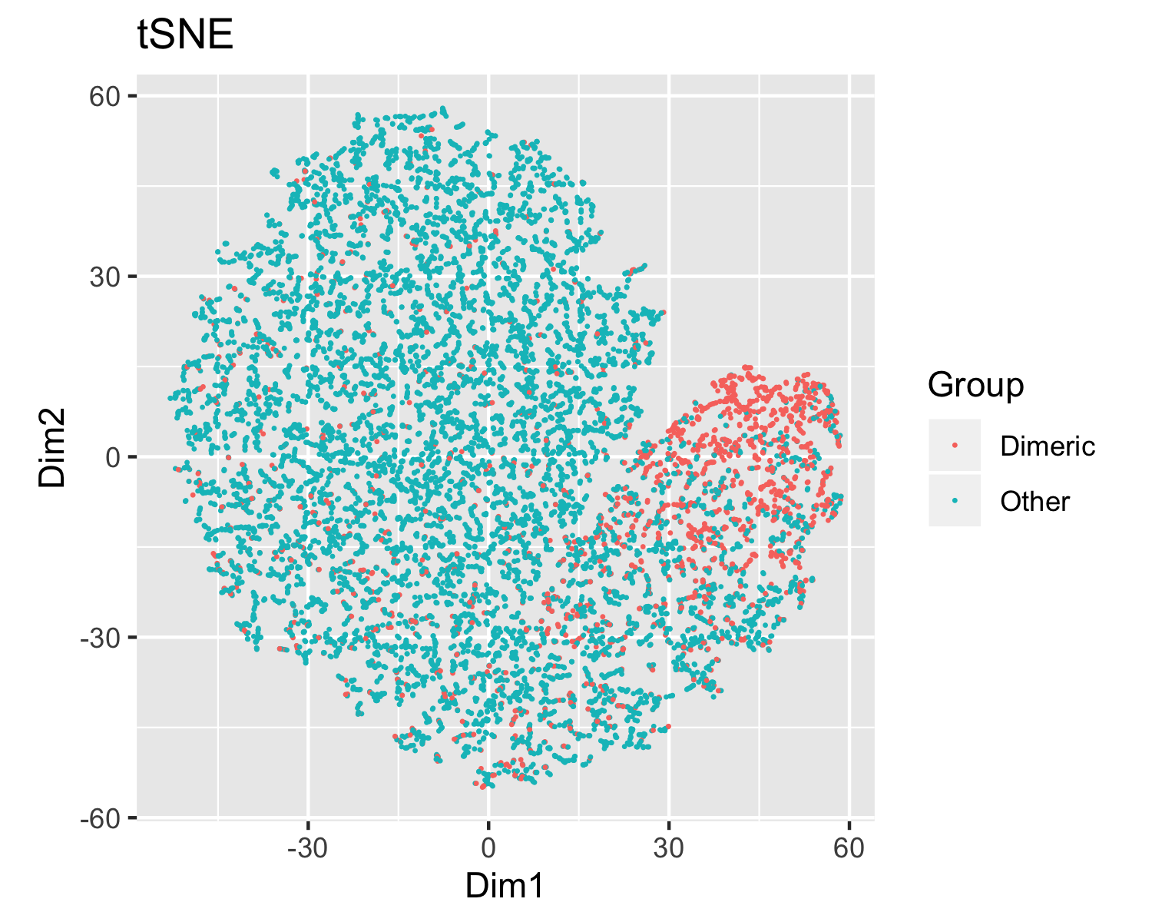

Example of Unbiased Identification of a Distinct Binding Mode in GR ChIP-exo

Slide 32




V-Plot
PNAS 2011
2D plot of
X: fragment center position
Y: fragment length
Genome Research 2015

Slide 33


V-Plot at HNF4a Binding Sites
V1
V2
HNF4a CUT&RUN (Park lab)
A
V
A
A
A
B
N
C
TF
C
N
N: nucleosome
B
Projection along the V-line
C
C
− strand signal
+ strand signal

Slide 34






Others
83kDa

Slide 35


SOX2 CUT&RUN – H1 Cell

Slide 36
Plan
Anchoring Peak
Bias correction
V-plot Matrix
Feature Extraction
Dimension Reduction
Clustering
Collective characterization

Slide 37
Long-term View
By different anchoring proteins
Same anchoring protein,
different neighboring
chromatin landscape
to be filled

Slide 38



Histone modification CUT&RUN
Previous enhancer stratification is mostly applies to TF CUT&RUN
What about histone modification CUT&RUN?
TF binding sites prediction
Genes & Development 2017

Slide 39

More Crazy Ideas
Can we predict 3D chromatin architecture using CUT&RUN?
Inspired from Yaping’s work
Mimicking ChIA-PET
eLife 2017

